Slide 1


TRUESIGHT
AI - Powered Spoofing Detection System

Slide 2

Group Members
Hamayun Nasir 2022189
Ammaid Saleem 2022344
Asad Ali 2022903
Aizaz ur Rehman 2022078
Supervisor
Dr. M. Zain Siddiqui
Co - Supervisor
Dr. Khurram Khan Jadoon
Faculty of Computer Sciences and Engineering
Ghulam Ishaq Khan Institute of Engineering Sciences and Technology, Pakistan

Slide 3



PROJECT OVERVIEW
PROBLEM
OUR SOLUTION
Core Values
AI-generated deepfakes are becoming more realistic and harder to detect, leading to risks like misinformation, identity fraud, and loss of digital trust. Existing solutions lack multi-modal detection and reliable forensic verification.
TrueSight is an AI-powered system that detects deepfakes across video, audio, and multilingual content using advanced machine learning and forensic analysis. It provides real-time detection, secure evidence tracking, and scalable enterprise deployment.
Our project focuses on accuracy, security, transparency, and scalability. We aim to ensure trustworthy digital media verification through reliable AI detection, strong cybersecurity practices, and legally admissible evidence handling.

Slide 4



MODERN TOOLS &
TECHNOLOGIES
BACKEND
FRONTEND
INFRASTRUCTURE
PYTHON 3.13, FASTAPI, PYTORCH, LNCLIP, WAV2VEC2, PHONEME-BASED NLP MODEL, POSTGRESQL
REACT 18, MODERN UI COMPONENTS, INTERACTIVE CHARTS & ANALYTICS
MICROSERVICES ARCHITECTURE, DOCKER, KUBERNETES, RTMP/HTTP STREAMING, BLOCKCHAIN LEDGER, SMART CONTRACTS, ZERO TRUST SECURITY ARCHITECTURE

Slide 5

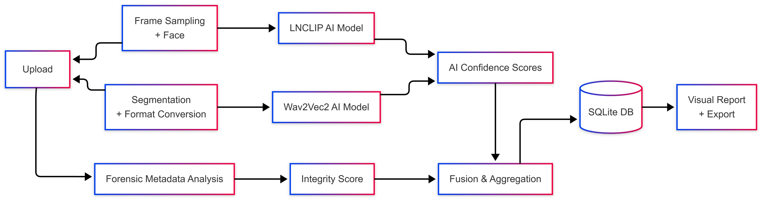
SOLUTION
ARCHITECTURE

Slide 6
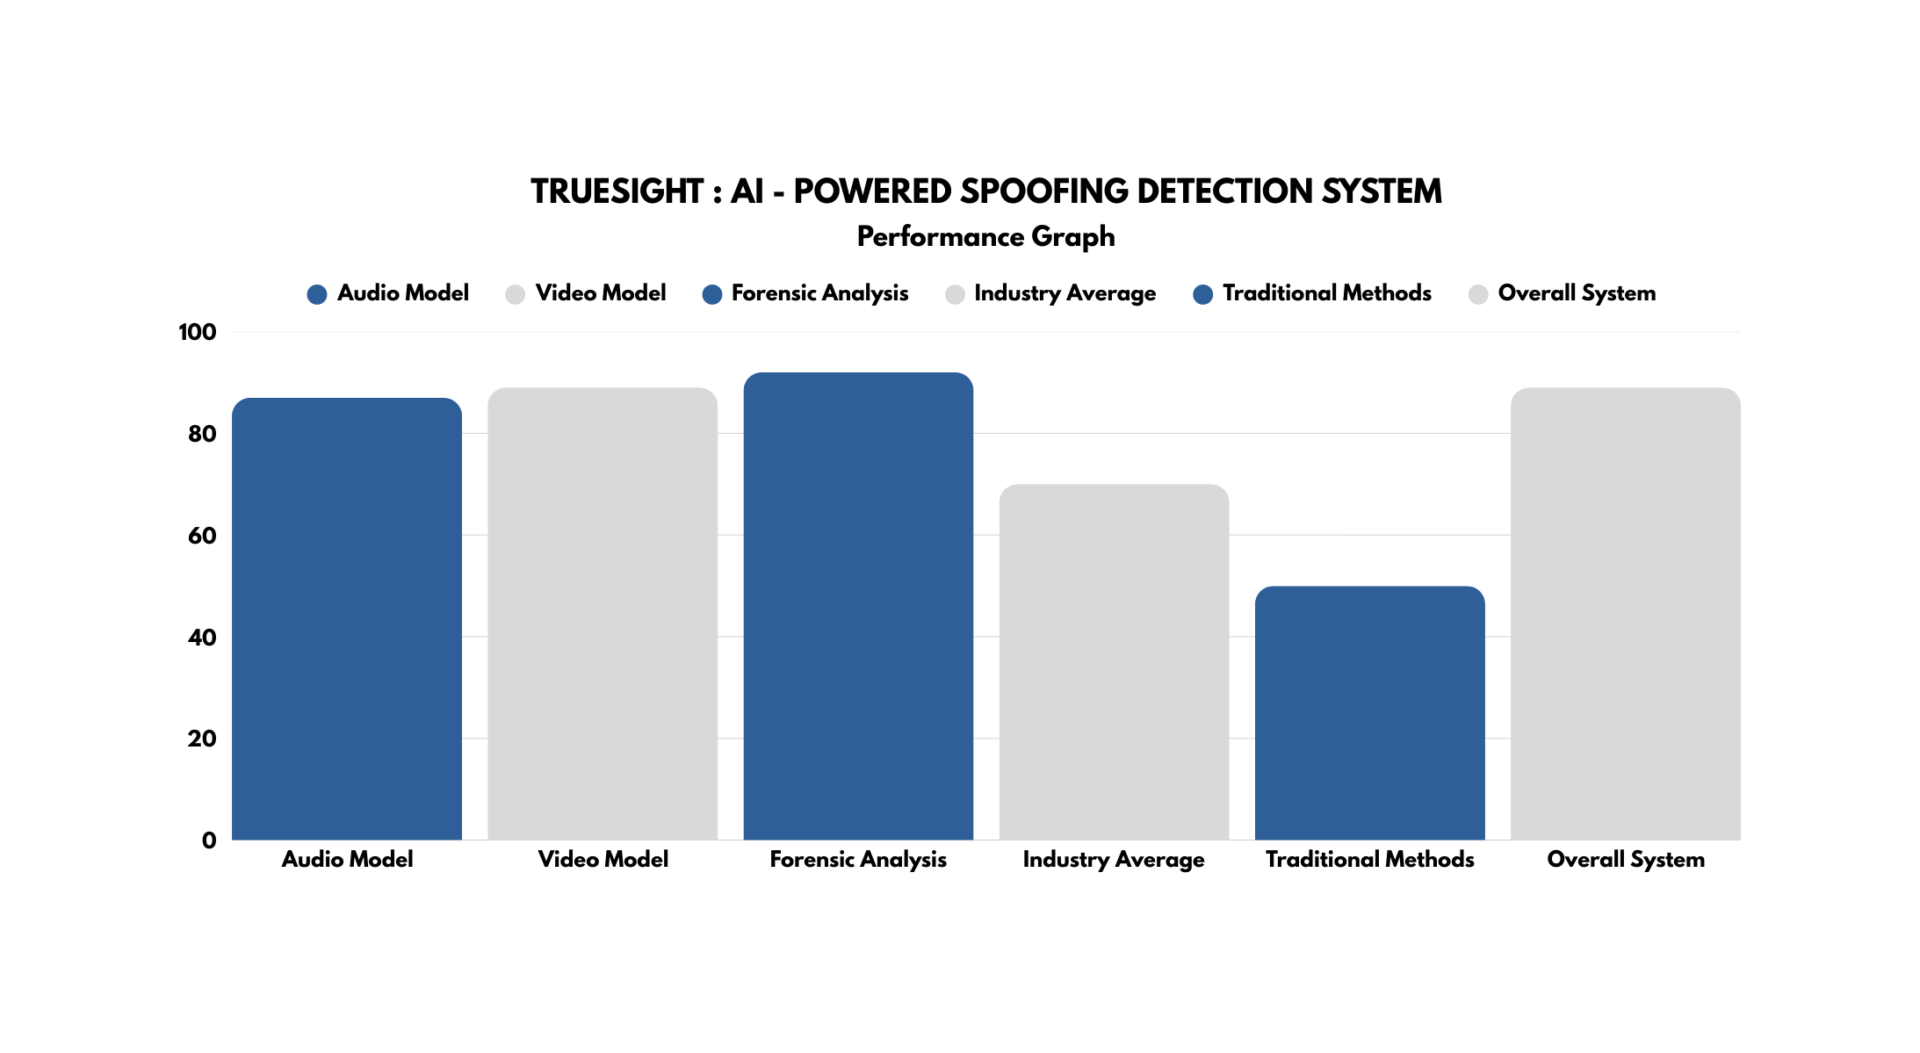


Slide 7

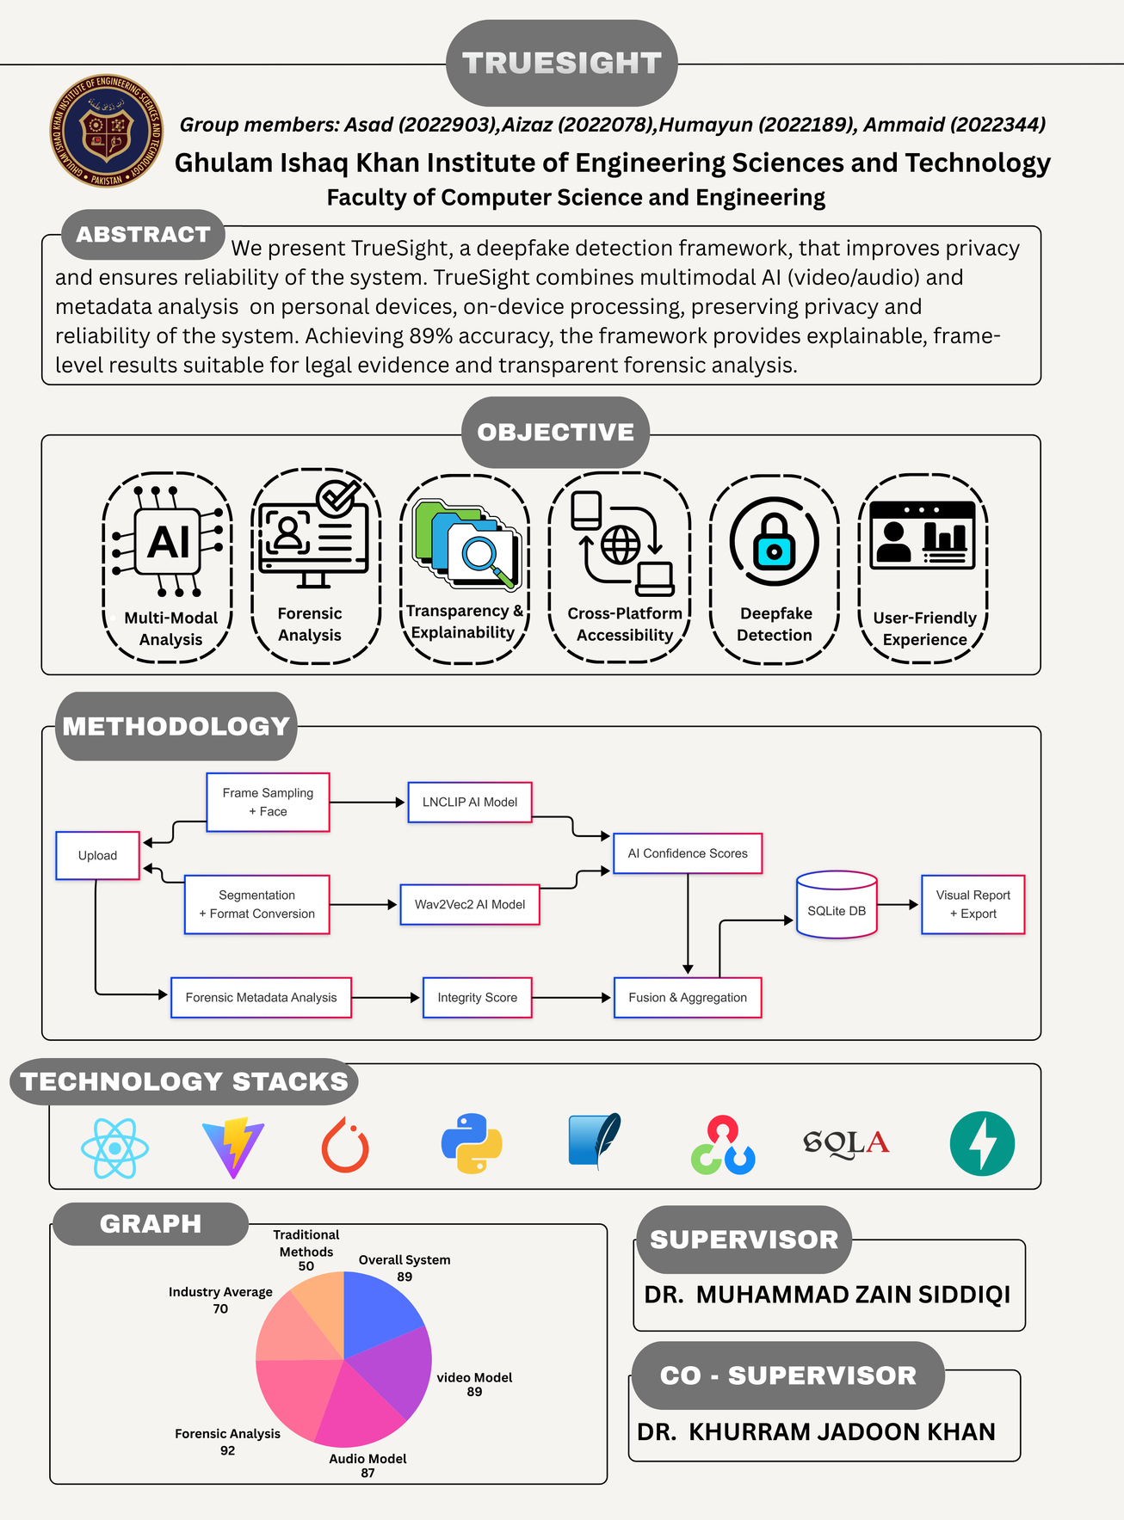
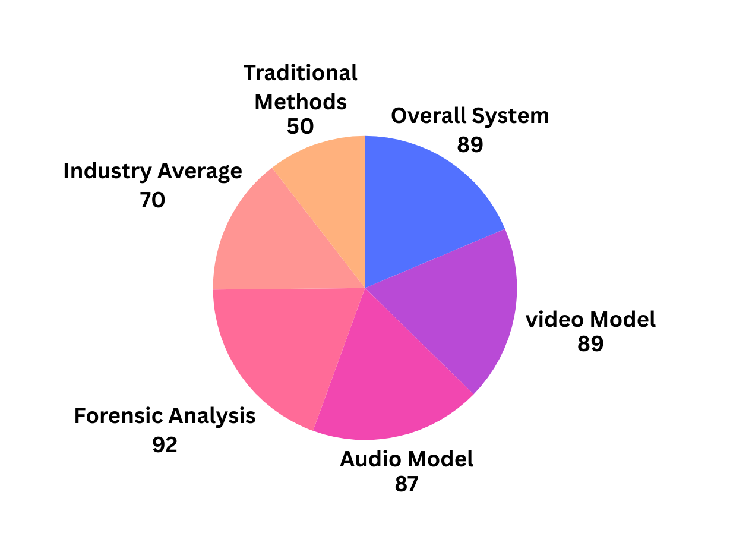
POSTER
DESIGN

Slide 8

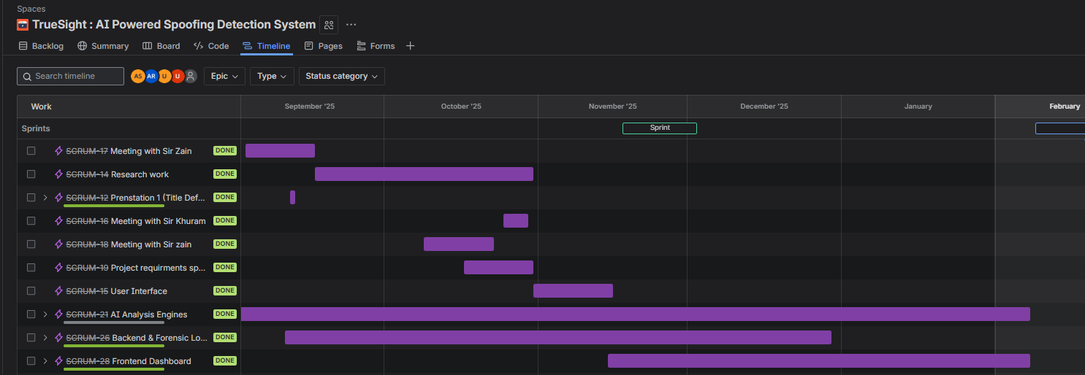
PROGRESS
TRACKING

Slide 9


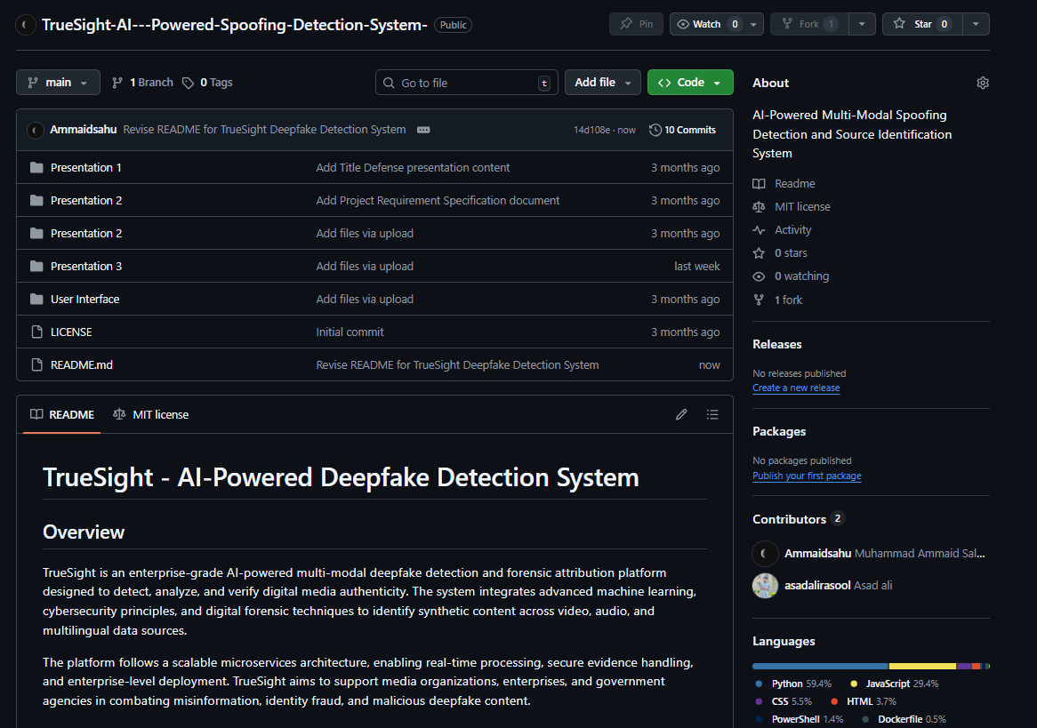
GITHUB
REPOSITORY
https://github.com/Ammaidsahu/TrueSight-AI---Powered-Spoofing-Detection-System-.git

Slide 10

THANK YOU

